Slide 1
Evidence for evolution
Fossil studies

Slide 2
Fossils
Any preserved trace left by an organism that lived long ago.
Bones, shells and teeth are the most common finds
Fossils help to develop a picture of the past.
They also can build up a sequence of evolutionary change for a particular plant or animal.

Slide 3
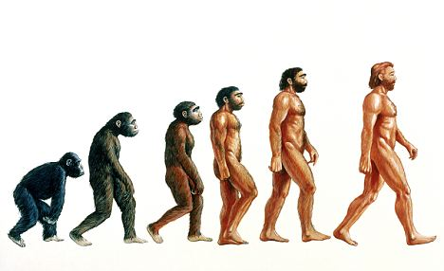

Slide 4
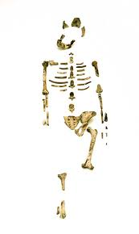
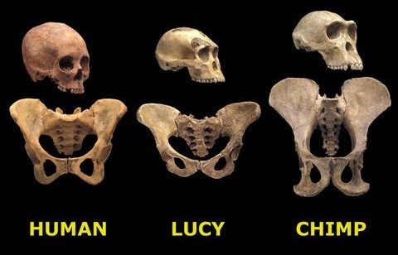
Lucy
Discovered in 1972 near the village of Hadar in Ethiopia.
Dated back to about 3.2 million years ago using argon-argon dating.
Earliest known sample of Australopithecine

Slide 5
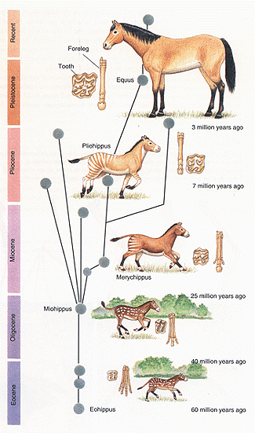
Example: the horse

Slide 6
Fossil formation
Usually organisms are completely destroyed by micro-organisms
Part of an organism may be fossilised if they are buried quickly and decomposition is slowed or prevented:
Volcanic ash and mud carried by flooding rivers are examples.
Soil that contains no oxygen such as peat allow for preservation by preventing decomposition.

Slide 7
Fossil formation
Alkaline soils produce the best fossils. The pores in the bone are filled with new minerals. The bones itself is not dissolved. The bone is petrified (turned into rock) and details of the structure are preserved.

Slide 8
Dating fossils
A fossil really only has value if its age can be determined. That way it can be put in the appropriate place in a historical sequence.
Absolute date: an actual estimate of the age of the specimen in years.
Relative date: tell us if one sample is older or younger than another sample.

Slide 9
ABSOLUTE DATING

Slide 10
Absolute dating
Using radioactive isotopes:
Elements have different possible atomic masses:
  Potassium: 39, 40, 41
  Carbon: 12, 14
The mass is due to extra neutrons in the nucleus of the atom.
Atoms can lose neutrons to form a different isotope. Other radioactive forms of an element can lose protons to become a different type of atom. By comparing the amount of these isotopes in a rock sample scientists can estimate how old the rock layer is.

Slide 11
Potassium-argon dating
Potassium-40 is radioactive and will decay to form calcium-40 and argon-40.
If the amount of potassium-40 and argon-40 is measured the age of the rock can be calculated because the above decay happens at a slow (but constant rate). Half life approx 1.26 billion years.

Slide 12
Potassium-argon dating
Limitations
  Not all rocks are suitable (contain potassium-40)
  It can only date rocks older than 100 000 – 200 000 years. This is due to the amount of argon-40 in younger rocks is so miniscule it cannot be detected.
  A suitable rock the same age as the fossil must be found. E.g. rocks formed from volcanic eruptions bury bones.

Slide 13
Carbon-14 dating
Carbon-14 is produced in the upper atmosphere as a result of cosmic radiation on nitrogen. There is one atom of carbon-14 for every million million atoms of carbon-12.
Plants and animals take up carbon – of which one carbon atom will be Carbon-14 for every million million atoms of Carbon
When the organism dies. They no longer take up Carbon-14. The carbon-14 in their remains will decay to Nitrogen at a known rate.

Slide 14
Carbon-14 dating
Half of the Carbon-14 decays every 5730 years (give or take 40 years)
Material over 60 000 years old cannot be dated as the amount Carbon-14 is negligible.
The material dated needs to be organic in nature: cave paintings, charcoal from cooking fires, bones, wood.

Slide 15
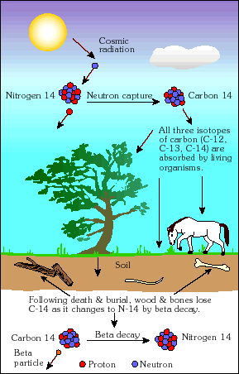

Slide 16
Tree ring dating (dendrochronology)
Rings on the surface of a tree trunk represent one years worth of growth.
Certain rings that produced in years of exceptional weather can be used as marker rings.
Living trees can be compared with timber taken from human structures and the marker rings can be used to correlate the two pieces.

Slide 17
RELATIVE DATING
(NOT THE TASMANIAN TYPE)

Slide 18
Relative dating
The purpose is to get a sequence of events – not an actual age in years
Stratigraphy: the study of layers (strata) of rock.
Sedimentary rock: rock formed from the laying down of sediments (materials carried by water)

Slide 19
Stratigraphy
When considering sedimentary rock, the strata layer on top is younger than the layer beneath it
The rule needs to be applied carefully. Layers can be turned upside down. Fossils and artefacts may be buried by animals in layers that are older

Slide 20
Stratigraphy
Rocks that contain the same fossils may be assumed to be the same age.
Index fossils – are fossils that were widespread but were only found on earth for a limited period of time.
In this way different rock strata can be correlated and information gleaned in one area used to analyse another.

Slide 21
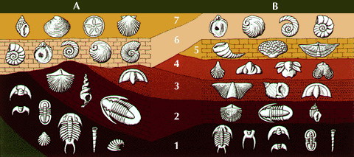

Slide 22
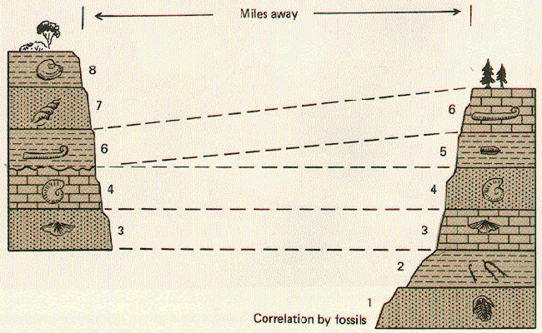

Slide 23
Fluorine dating
Fluoride ions present in water will replace the ions in bones. If all of the fossils found are of the same age they should have the same levels of fluorine.
Absolute ages are not possible as the amount of fluorine in water varies significantly over time and location.

Slide 24
Phylogenetic trees
A diagram used to represent evolutionary relationships between species
The base of the tree is formed by the ancestral species and any species that has risen from that ancestor forms the branches.
The closer together the branches, the more closely related species are thought to be.

Slide 25
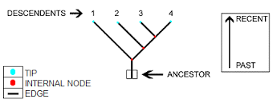
Phylogenetic trees

Slide 26
The geological time scale
The time scale is broken into
  Eras
  Which are further divided into periods
  Which are further divided into epochs

Slide 27
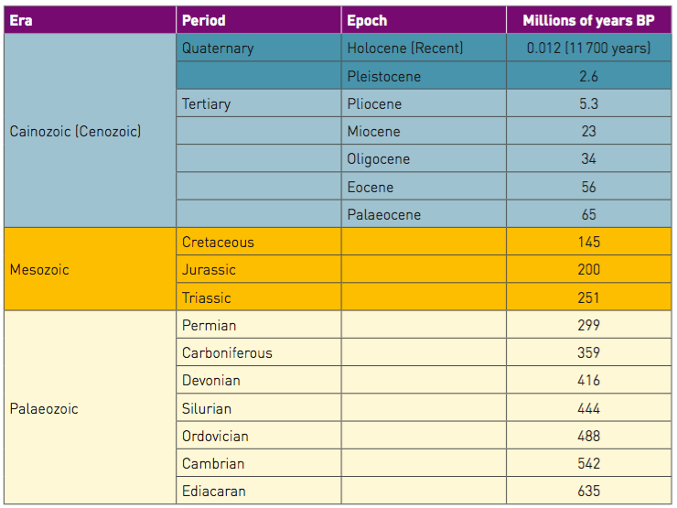

Slide 28
Problems with the fossil record
The fossil record is incomplete – as conditions required for fossilisation mean they occur irregularly regarding time and location. They require:
  Quick burial
  Presence of hard body parts
  Absence of decay organisms
  Organism left undisturbed

Slide 29
Problems with the fossil record
Discovery: only a small number of fossils that exist have been discovered.
When discovered dating can be very difficult.
Fossils are usually found fragmented rather than whole. Often are from a few fragments, scientists need to infer a great deal about the structure of the organism as a whole.

